Slide 1

Prediction
Name: DISHA JAIN
SECTION: ML
UNIVERSITY ROLL NO. :
2021878

Slide 2
INTRODUCTION
Customers are the foremost requirement or the demand for a successful business. Entrepreneurship is the outstanding domain which is currently outgrowing in this market
Different ways of attracting new ideal potential customers to avail different services and products or to retaining the existing ones and gaining their loyalty, so that they won’t churn from the services and the products they are using should be one of the major concerns of a business or a startup.
Churning is the process of switching from one service to another. So, customers switching from one service that they currently using or is indulging in to another service or product due to their not satisfying services, weak customer retention, or maybe they are more interested in the offers or the benefits which other service is providing
It is one of the challenging tasks for the business to attract ideal potential customers to use their services and retain the loyalty of the existing customer to stop them from churning. So, machine learning once again came as a helping hand to build different model which on various insights, various criteria can predict that whether the respective customer will churn or not. This model can be proved to be of great help.

Slide 3
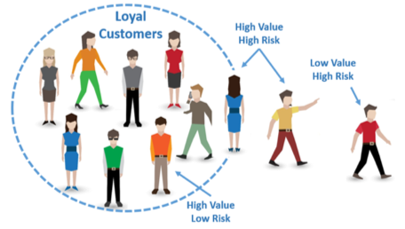
PROBLEM STATEMENT We have tried making a model for helping business in their customer retention, i.e., customer churn prediction model. We have been given with a dataset in which their different criteria like senior citizen, gender, partnership, internet service, online service, online backup, and many more of a telecom industry. We will first be taking the insights by doing the EDA part from the dataset, cleaning it, and then training it on the criteria’s due to which the prediction will be affected the most. We will be following the complete model making procedure from data cleaning to taking insights to training the data to testing. We have to make the nearest precise churn prediction model which can result in prediction of churn rate as well and will be helpful in the real world.

Slide 4
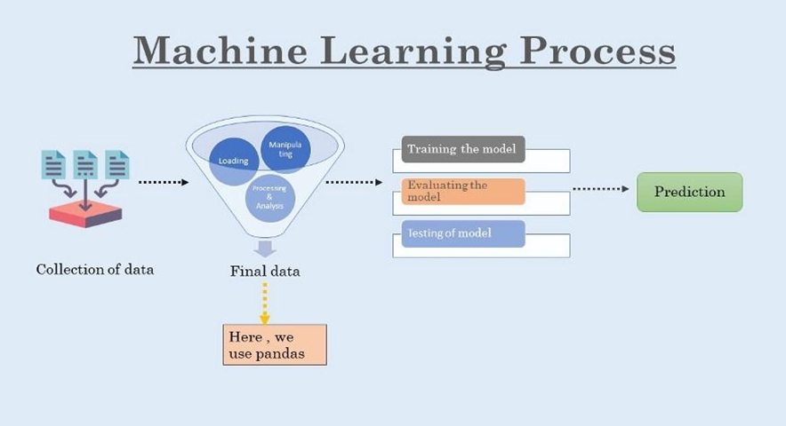
METHADOLOGY
A systematic process is being followed to build a model which we will be discussing in this section. The first step in this is the dataset collection phase, followed by preprocessing, then implementing selection features and then training and testing the dataset and then finally running the model to predict WHETHER CUSTOMER WILL CHURN OR NOT and declare it to be YES or NO. We have taken the use of machine learning to build our model.

Slide 5
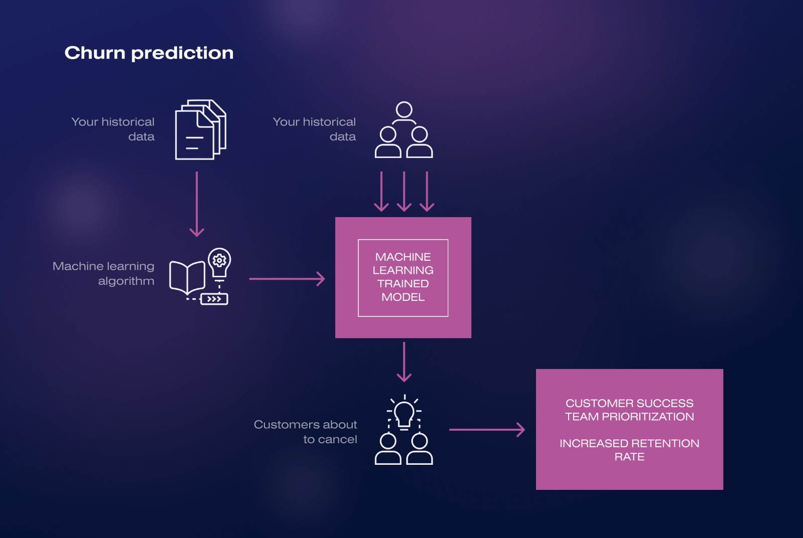
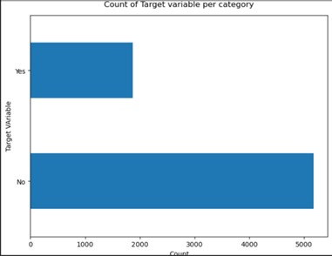
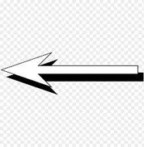
This image shows how the Dataset is firstly preprocessed, in which it deals with missing values, cleaning of data and also taking insights which is one of the most important part before training or testing.
This is the output of our dataset which we are using to build this model. This image shows the count of customers in total who will churn from the services they are availing provided in our dataset. This gives a wholesome picture of our dataset.

Slide 6
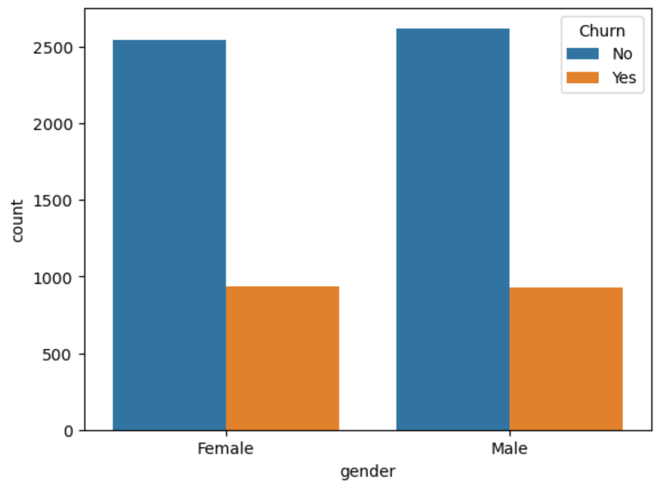
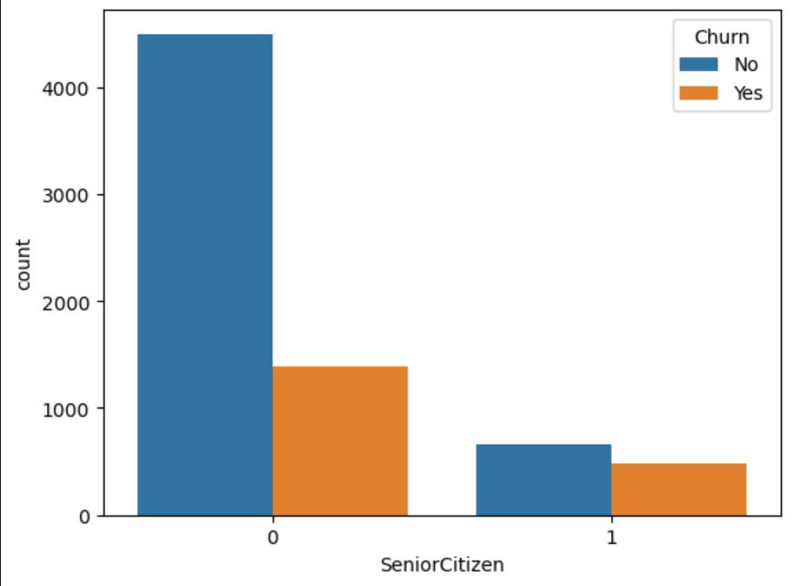
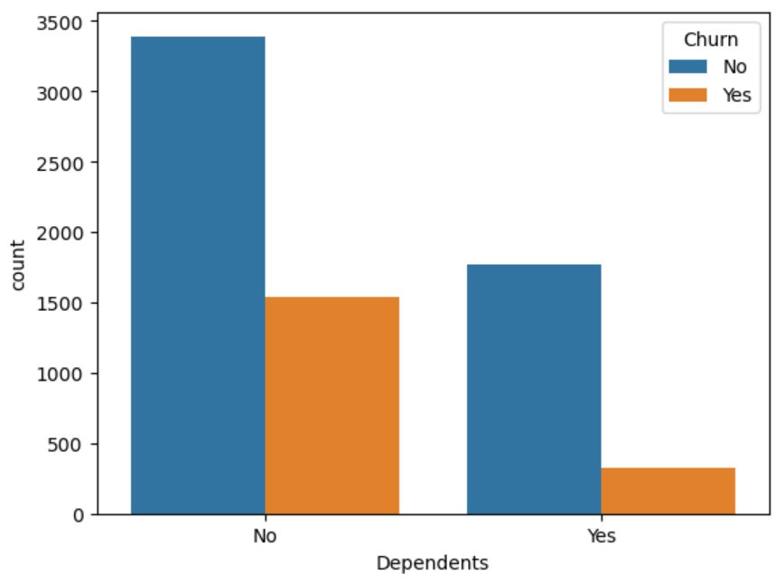
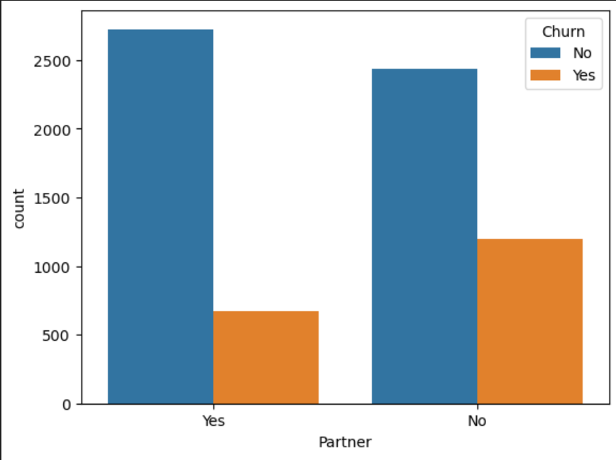
Insights
After doing pre-processing of data, we have done data exploration for taking the data insights. So, to select the best categories and examine them among gender, senior citizen, partnership, internet service, online service, online backup and many more that. among these criteria’s which should be used for training the model because o which the model will be most affected.
These are the bar graphs produced on exploring data on various categories. They show how much customers will churn or not on the basis of particular criteria.
After getting insights from this information, we used machine learning to train the model

Slide 7
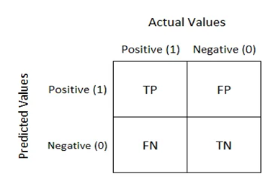
RESULT
After applying various supervised machine learning algorithms and also by taking the help of confusion matrices , we concluded that which algorithm we have to use to train our model , so that it will give us the most precise result.
Confusion matrix is a table of two rows and two columns consisting true positive, false positive, false negative and true negative.
It is called so as it is used in predictive analysis, i.e., it is used to predict whether the machine is confused between the two.

Slide 8
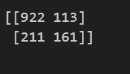
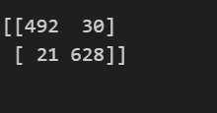
Random forest thus proves to be a better algorithm since it makes it easy to visualise the data and is a further classified version of decision tree. So, it is a more improved one. It works according to the voting procedure; this works for the majority. Thus, with an accuracy score of 95.64% random forest algorithm proved to be the best to train our model.
This is the confusion matrix of random forest classifier algorithm which shows that random forest supervised machine learning algorithm gives less negative statement as compared to decision tree classifier, i.e., this algorithm do its best to predict the result.
This is the confusion matrix of random forest classifier algorithm after applying SMOTE-ENN technique to reduce overlapping in result and hence it decreases the number of false negative when applied for training on various criteria’s.

Slide 9
CONCLUSION
These emerging technologies is a big push to the business world as well. Customer churn prediction model has proved to be a great use for new startups or the existing business. We have used different machine learning techniques and SMOTE-ENN technique to build the model. SMOTE-ENN is a technique to avoid overlapping content. This technique helps in precision of the result. But, making these machine-based model to produce exact precise result to be implemented and get the correct output is not easy. Since, these types of models are trained based on large amount of data having different categories and criteria. Predicting human behaviour through machine is a less precise thing.
Future work can include, models being made by working on more re-fined dataset pre-processed, cleaned and having more decisive results. Applying more optimized techniques to increase the precision of the output is yet need to be examined. As this business is not an area of experiments, because they are the most affected fields, they work on accuracy only.

Slide 10
Thank You

